Slide 1
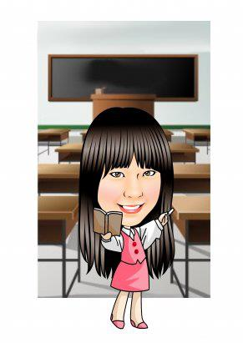
Hello, everyone!
I’m your English teacher.
My name is ________
Mandy

Slide 2
Classroom English

Slide 3
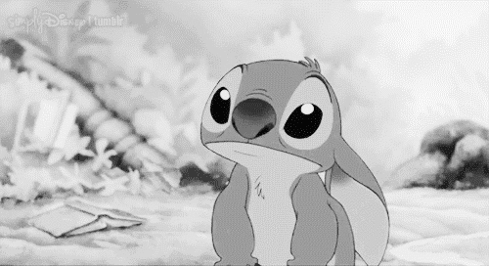
Listen!

Slide 4
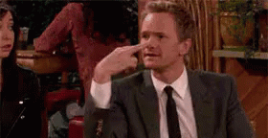
Look.

Slide 5
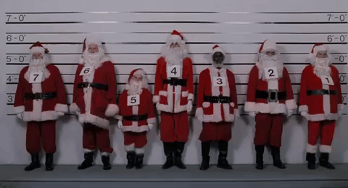
Line up.

Slide 6
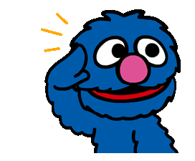
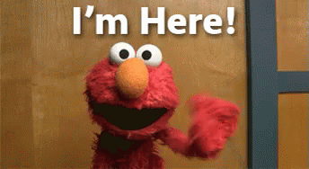
Repeat after me.
Say “I’m here!”

Slide 7
Stand up.

Slide 8
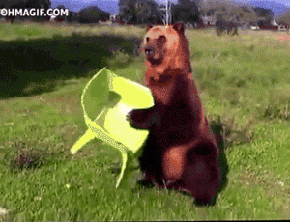
Sit down.

Slide 9
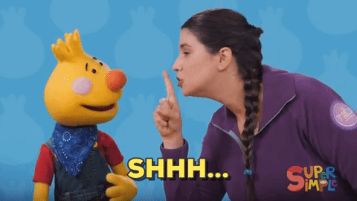
Be quiet, please.

Slide 10
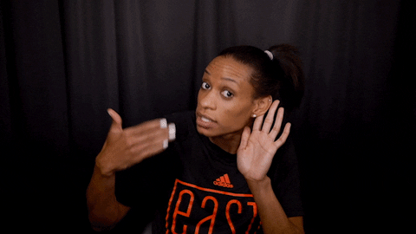
Louder, please.

Slide 11
1
2
3
4
Say “I’m here!”
5
6
7
8

Slide 13
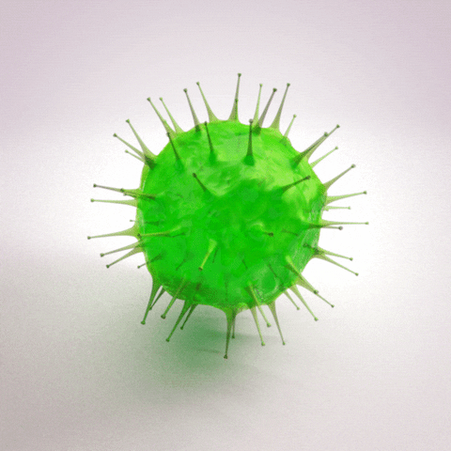
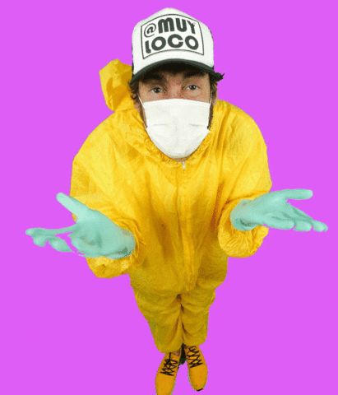
Self-introduction of Coronavirus
冠狀病毒的自我介紹

Slide 25
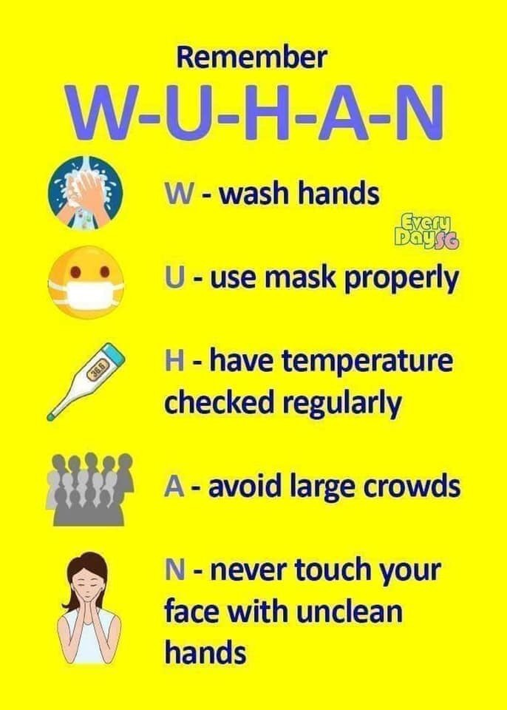

Slide 26
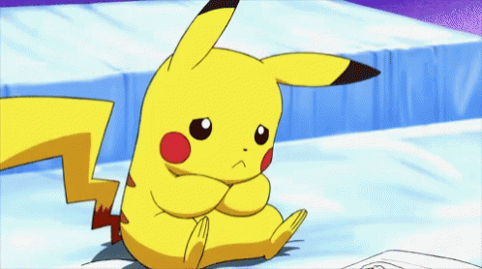
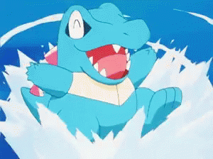
How are you?
I’m not so good.
I’m great!

Slide 28
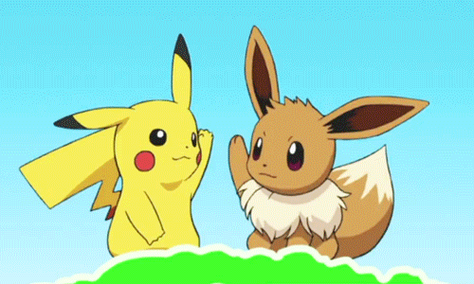
Hi! My name is Pikachu.
What’s your name?
My name is Eevee.

Slide 29
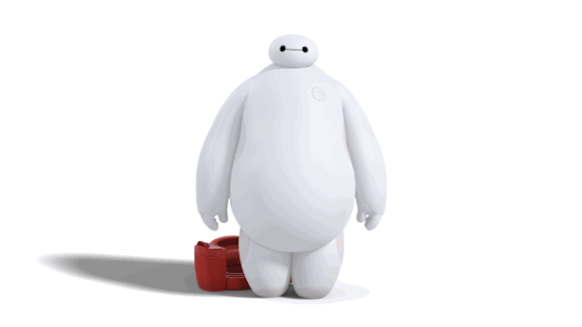
Hi! My name is Baymax.
Nice to meet you!

Slide 30
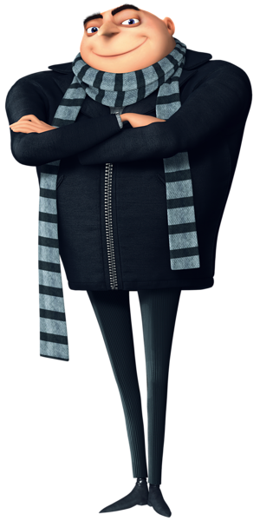
Hey! How are you?
What’s your name?
Hello!
I’m the cutest
Minion Carl.

Slide 31
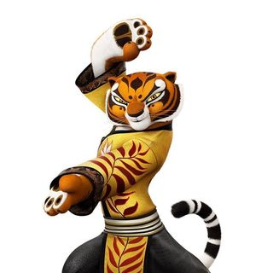
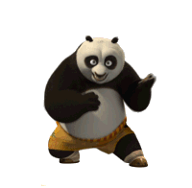
Hey! You’re amazing!
What’s your name?
My name is Po.
I’m good at Kung Fu.

Slide 32
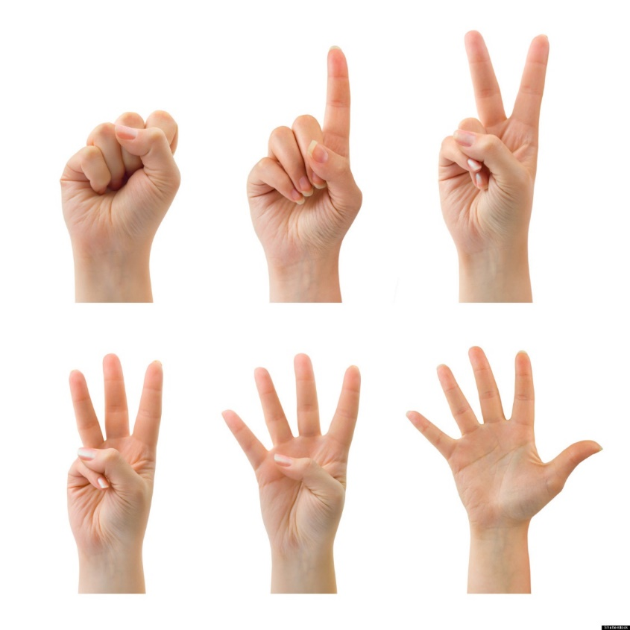
Let’s count!

Slide 33
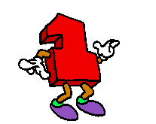
one

Slide 34
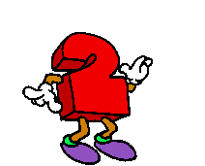
two

Slide 35
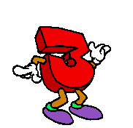
three

Slide 36
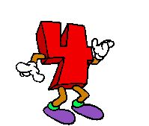
four

Slide 37
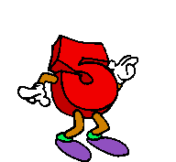
five

Slide 38
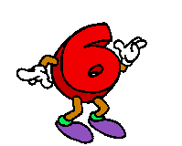
six

Slide 39
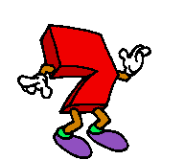
seven

Slide 40
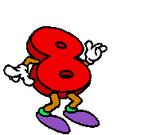
eight

Slide 41
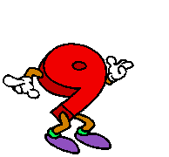
nine

Slide 42
ten

Slide 44
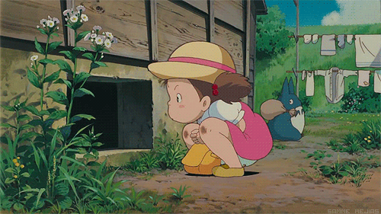
How old are you?
I’m four.
I’m four years old.

Slide 45
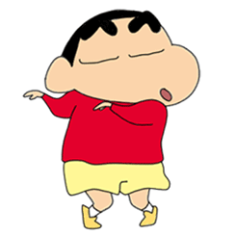
How old are you?
I’m five.
I’m five years old.

Slide 46
How old are you?
I’m seven.
I’m four years old.

Slide 47
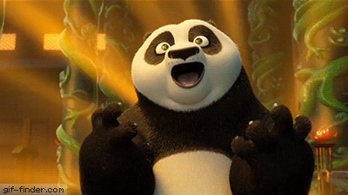
How old are you?
I’m ten.
I’m ten years old.

Slide 48
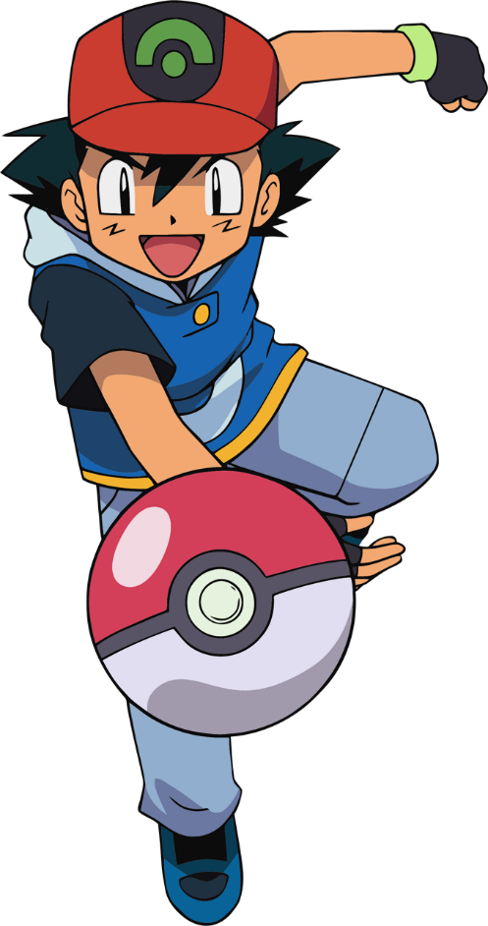
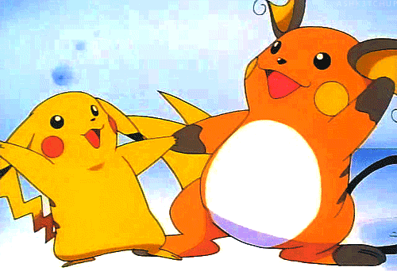
Review the old and learn the new.

Slide 49
How are you?
I’m fine.
I’m good.
I’m great.
I’m wonderful.
I’m tired.
I’m hungry.
I’m not so good.

Slide 50
What’s your name?
My name is ____.
I’m _____.

Slide 51
How old are you?
I’m eight.
I’m eight years old.

Slide 52
a book

Slide 53
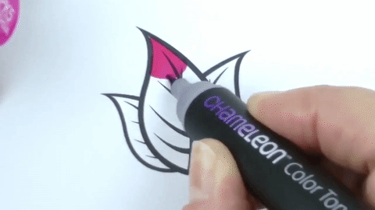
a marker

Slide 54
a pen

Slide 55
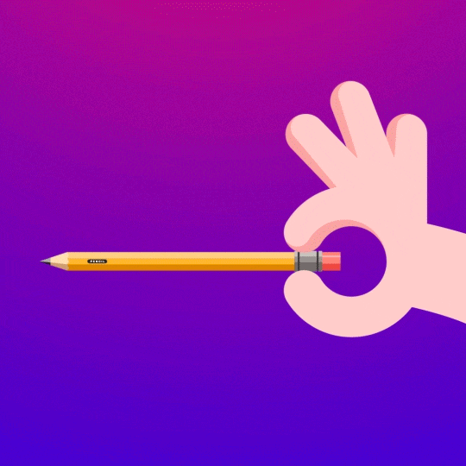
a pencil

Slide 56
a ruler

Slide 57
an eraser

Slide 60
(a/an)ant

Slide 61
(a/an)bird

Slide 62
(a/an)cat

Slide 63
(a/an)dog

Slide 64
(a/an)elephant

Slide 65
What’s this?
What’s that?

Slide 66
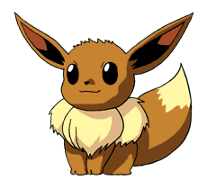
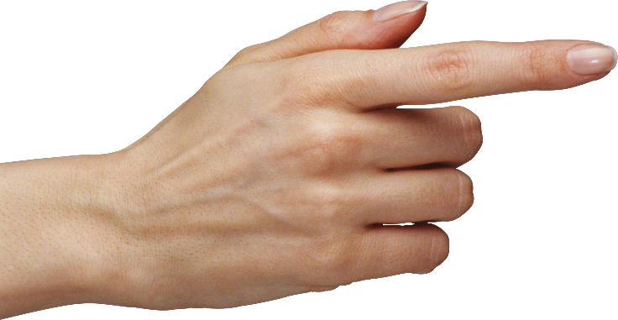
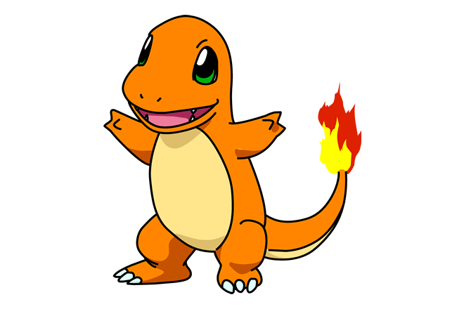
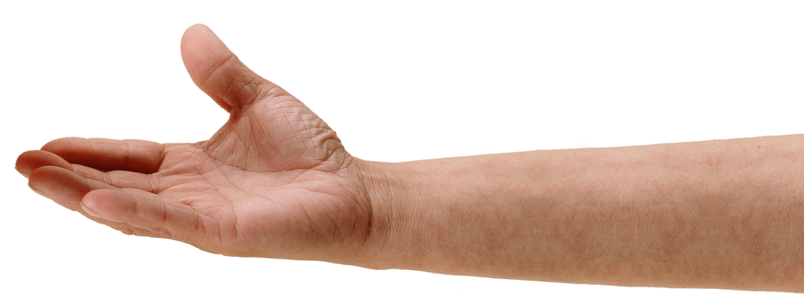
That is
Eevee.
This is Charmander.

Slide 67
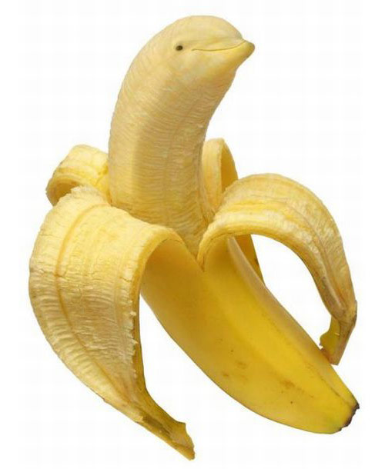
It’s a banana.
What’s this?

Slide 68
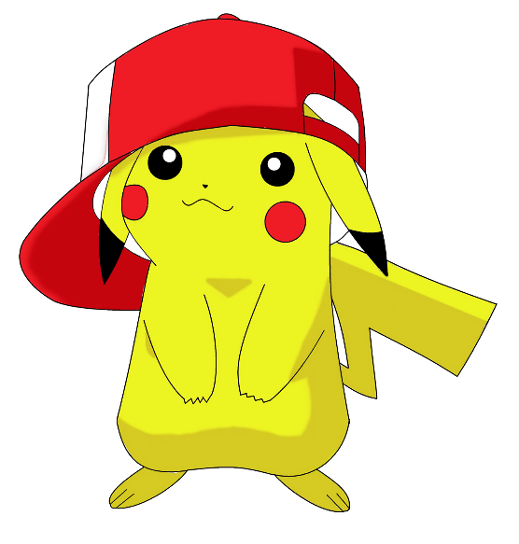
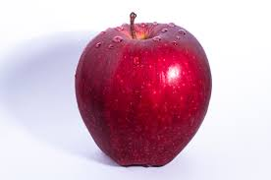
It’s an apple.
What’s that?

Slide 69
It’s a watermelon.
What’s this?

Slide 70
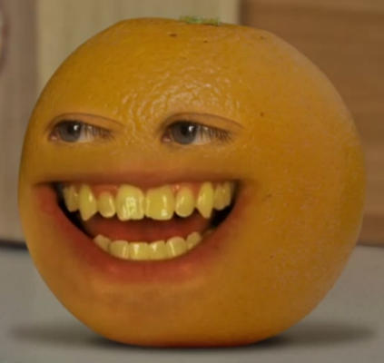
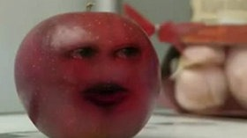
It’s an orange.
What’s that?

Slide 71
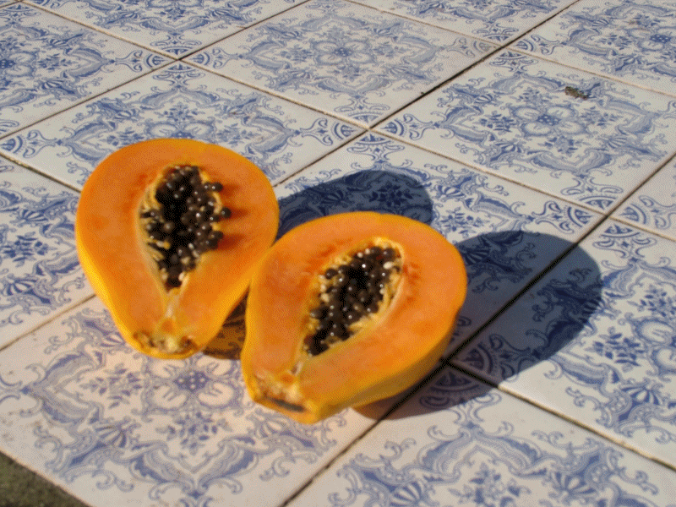
It’s a papaya.
What’s this?

Slide 72
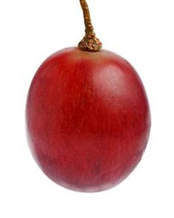
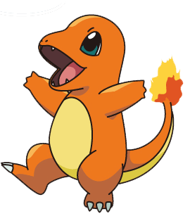
It’s a grape.
What’s that?

Slide 73
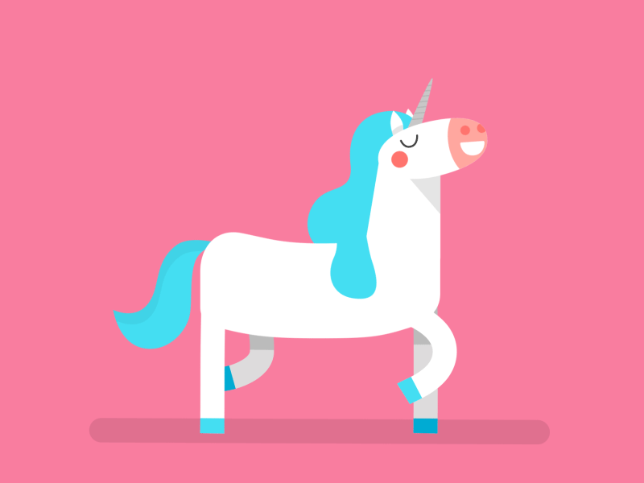
What color is this?

Slide 74
It’s blue.

Slide 75
It’s yellow.

Slide 76
It’s green.

Slide 77
It’s red.

Slide 78
It’s white.

Slide 79
It’s black.

Slide 80
Bingo
blue
yellow
green
red
white
black
book
pencil
pen
marker
ruler
eraser
this
that
a
an

